Slide 1
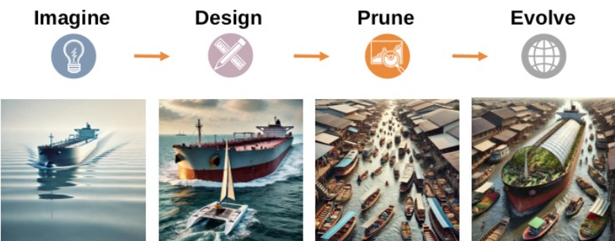
Applied ML for Mobility & Device Location
Signal Processing • Sensor Fusion • Real-Time Inference

Slide 2
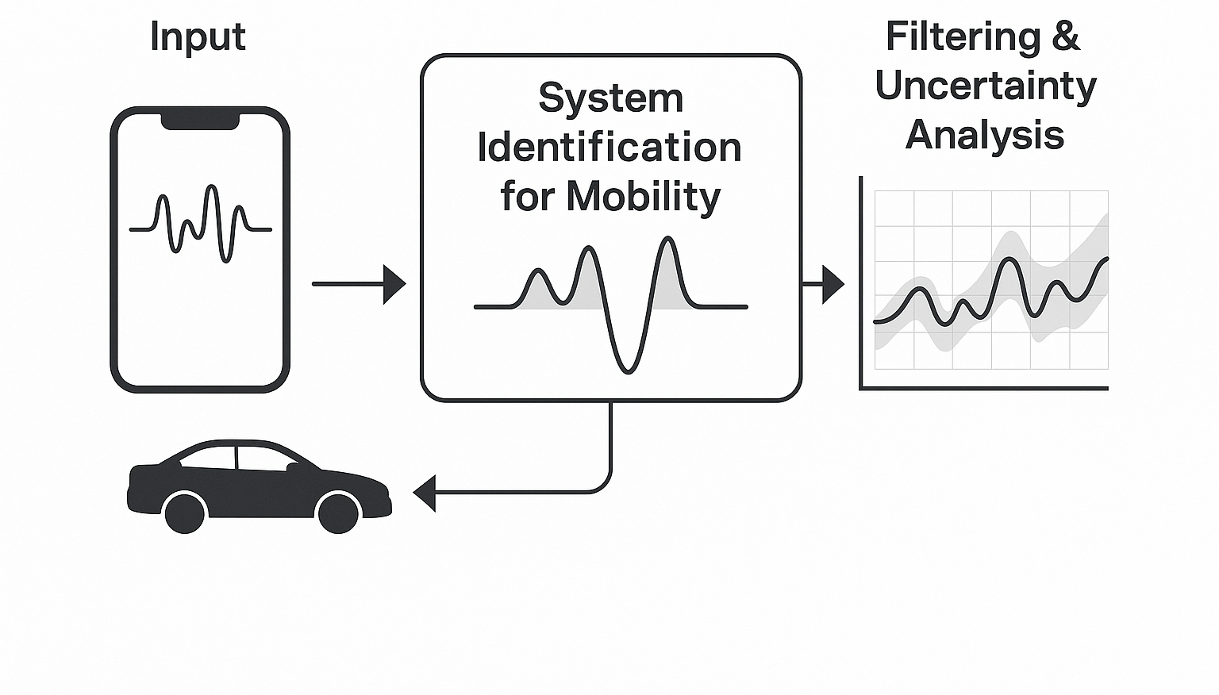
System Identification for Mobility & Physical Signals
Principle: Understand the physics and signal behavior before modeling — frequency content, dynamics, noise.
Where I applied it:
• Chalmers —device modeling & fitting to large datasets
• Volvo — FFT-based comfort signatures from acceleration data
Impact:
• Well cited publications within manufacturing, modelling, benchmarking and subjective quality
• Comfort inference as accurate as expert drivers
• Enabled automated gearbox tuning & HIL deployment

Slide 3
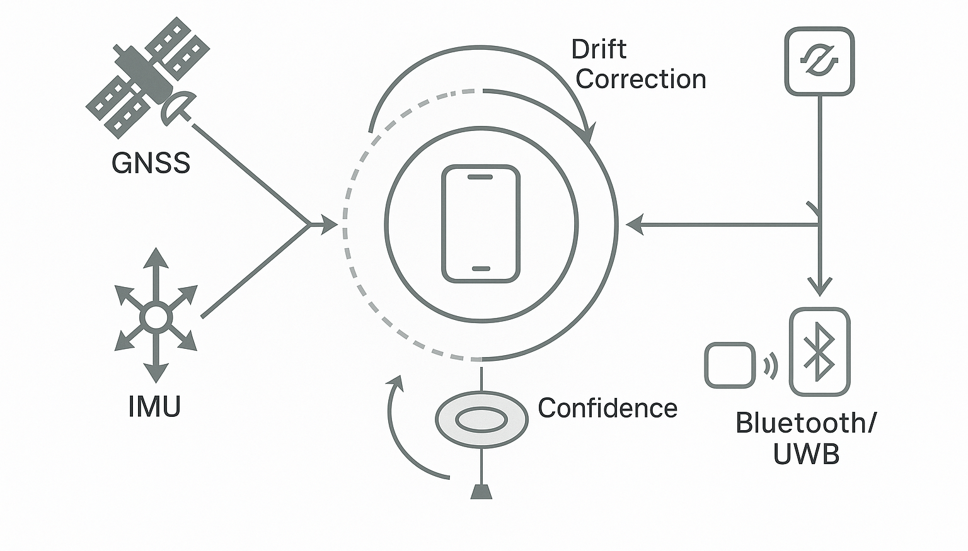
Kalman-Style Fusion & Confidence Tracking
Principle: Predict → measure → correct + track uncertainty. Confidence is a first-class output.
Where I applied it:
• Volvo — uncertainty-triggered retraining in real-time vehicle tests
• Dialysis monitor (soft-sensor) — feed-forward thermal model corrected by temperature anchors
Impact:
• Stable real-time inference in noisy environments
• Replaced costly hardware with inference + sensors (analogy: inertial + GPS fusion)

Slide 4
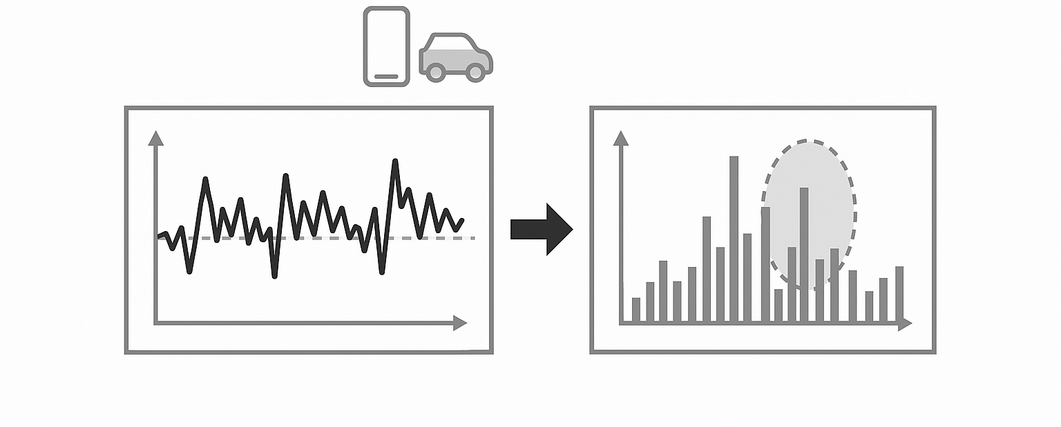
Motion Detection, Tracking & Mode Classification
Principle: Sliding clusterings → features → event detection → online adaptation.
Where I applied it:
• Volvo — re-classification in real-time
• SiB Solutions — focus training on high impact hardships
Impact:
• Continuously improving comfort model via driver feedback
• Lifted worst-case classification from ~34% to ~74% in a production product

Slide 5
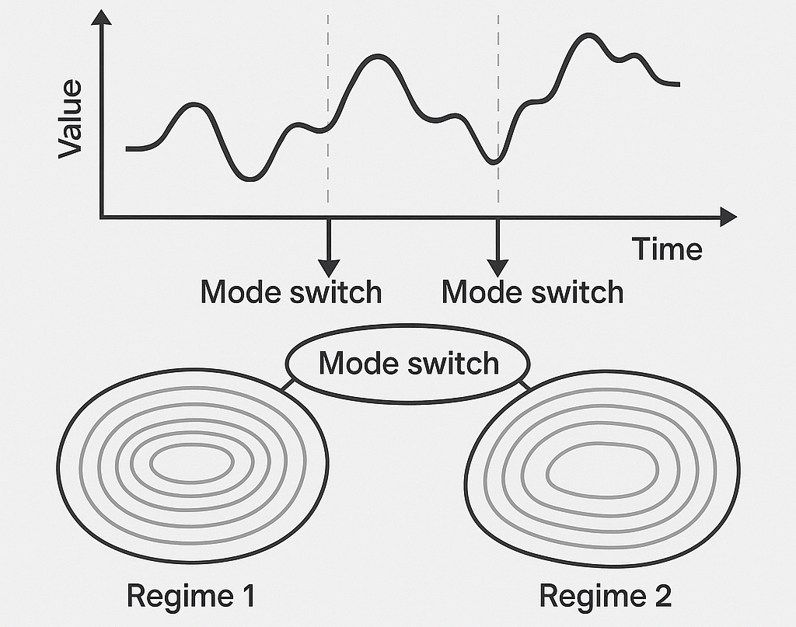
Regime Clustering & Operating Mode Segmentation
Principle: Systems operate in modes — detect regimes and specialize models instead of forcing one global one.
Where I applied it:
• SiB Solutions — separate hard vs easy object-cases, targeted training
• Ericsson — mode-segmented ad-hoc networking power consumtion analysis
Impact:
• Robust ML under distribution shifts
• Much more confident product marketing and safer operations planning during market shift

Slide 6
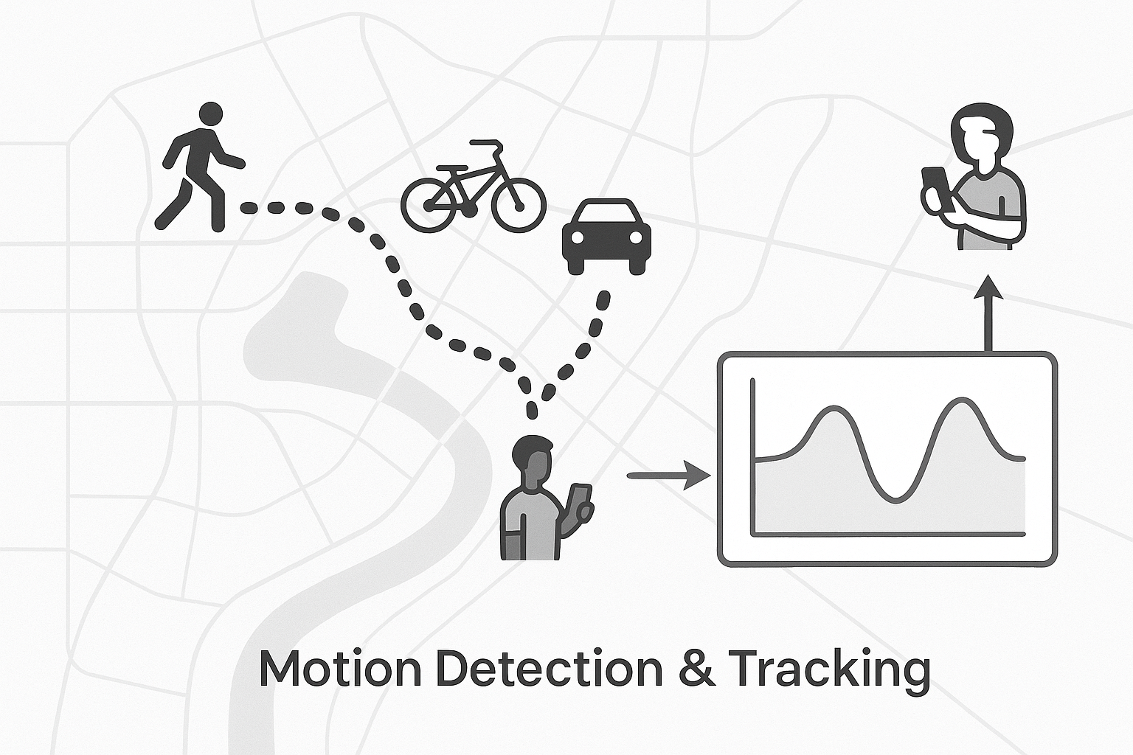
Hybrid GNSS + IMU + Opportunistic Anchors
Principle: Dead-reckon when needed, reset drift when anchors appear — fuse model + measurements.
Where I applied it:
• Dialysis soft-sensor — thermodynamic observer + PT100 sensors as anchors
• Volvo feed-forward control — prediction loop corrected by real-time feedback
Impact:
• Replaced complex hardware with model-driven estimation
• Low-latency stability on physical systems with drift correction

